Slide 1
Object-Oriented and
Classical Software Engineering
8th Edition, WCB/McGraw-Hill, 2010
Stephen R. Schach srs@vuse.vanderbilt.edu

Slide 2
CHAPTER 2
SOFTWARE
LIFE-CYCLE
MODELS

Slide 3
Overview
Software development in theory
Winburg mini case study
Lessons of the Winburg mini case study
Teal tractors mini case study
Iteration and incrementation
Winburg mini case study revisited
Risks and other aspects of iteration and incrementation
Managing iteration and incrementation
Other life-cycle models
Comparison of life-cycle models

Slide 4
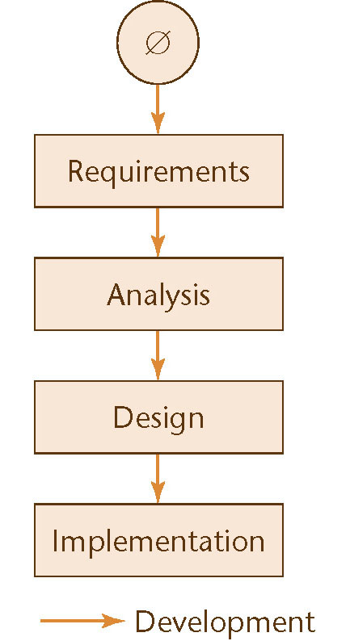
Software Development in Theory
Ideally, software is developed as described in Chapter 1
  Linear
  Starting from scratch
Figure 2.1

Slide 5
Software Development in Practice
In the real world, software development is totally different
  We make mistakes
  The client’s requirements change while the software product is being developed

Slide 6
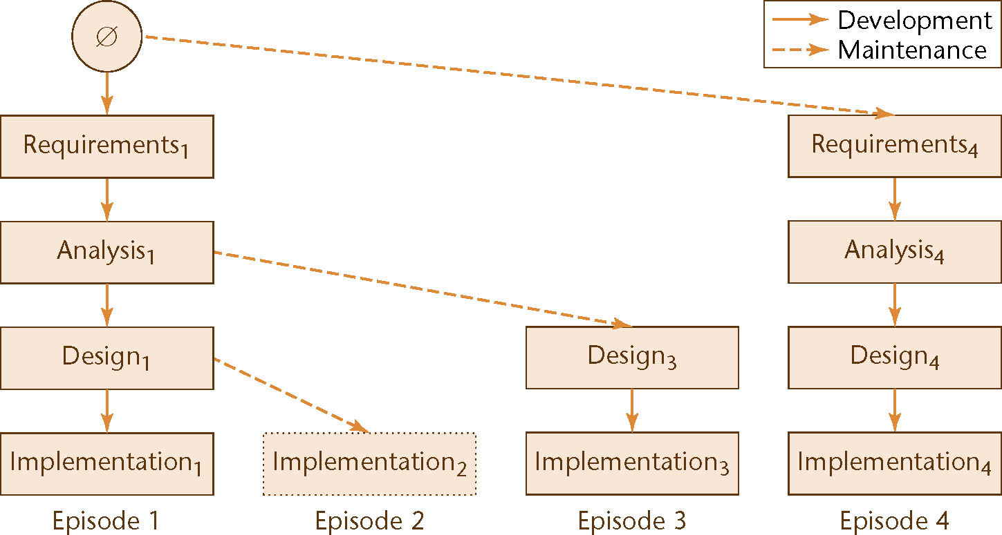
Evolution-Tree Model
Winburg Mini Case Study
Figure 2.2

Slide 7
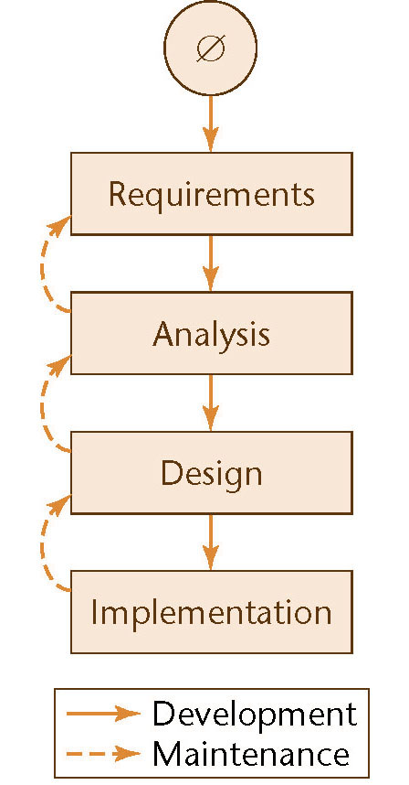
Waterfall Model
The linear life cycle model with feedback loops
  The waterfall model cannot show the order of events
Figure 2.3

Slide 8
Return to the Evolution-Tree Model
The explicit order of events is shown
At the end of each episode
  We have a baseline, a complete set of artifacts (constituent components)
Example:
  Baseline at the end of Episode 3:
    Requirements₁, Analysis₁, Design₃, Implementation₃

Slide 9
Moving Target Problem
A change in the requirements while the software product is being developed
Even if the reasons for the change are good, the software product can be adversely impacted
  Dependencies will be induced

Slide 10
Moving Target Problem (contd)
Any change made to a software product can potentially cause a regression fault
  A fault in an apparently unrelated part of the software
If there are too many changes
  The entire product may have to be redesigned and reimplemented

Slide 11
Moving Target Problem (contd)
Change is inevitable
  Growing companies are always going to change
  If the individual calling for changes has sufficient clout, nothing can be done about it
There is no solution to the moving target problem

Slide 12
Iteration and Incrementation
In real life, we cannot speak about “the analysis phase”
  Instead, the operations of the analysis phase are spread out over the life cycle
The basic software development process is iterative
  Each successive version is intended to be closer to its target than its predecessor

Slide 13
Miller’s Law
At any one time, we can concentrate on only approximately seven chunks (units of information)
To handle larger amounts of information, use stepwise refinement
  Concentrate on the aspects that are currently the most important
  Postpone aspects that are currently less critical
  Every aspect is eventually handled, but in order of current importance
This is an incremental process

Slide 14
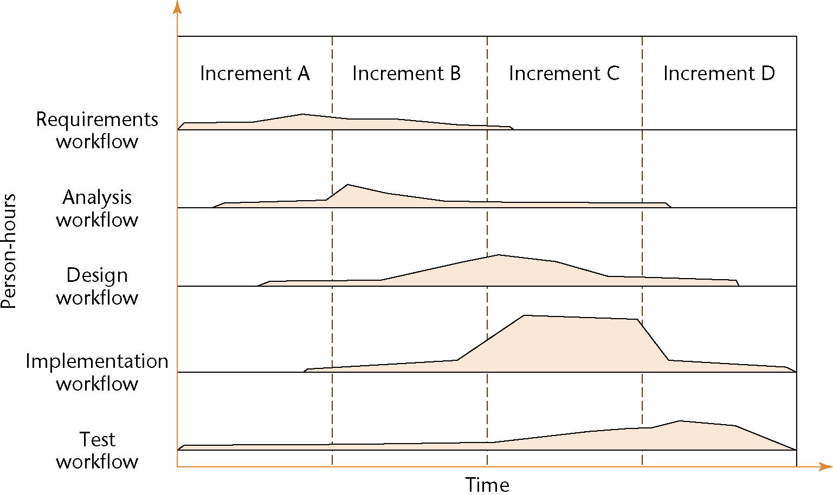
Iteration and Incrementation (contd)
Figure 2.4

Slide 15
Iteration and Incrementation (contd)
Iteration and incrementation are used in conjunction with one another
  There is no single “requirements phase” or “design phase”
  Instead, there are multiple instances of each phase
Figure 2.2 (again)

Slide 16
Iteration and Incrementation (contd)
The number of increments will vary — it does not have to be four

Slide 17
Classical Phases versus Workflows
Sequential phases do not exist in the real world
Instead, the five core workflows (activities) are performed over the entire life cycle
  Requirements workflow
  Analysis workflow
  Design workflow
  Implementation workflow
  Test workflow

Slide 18
Workflows
All five core workflows are performed over the entire life cycle
However, at most times one workflow predominates
Examples:
  At the beginning of the life cycle
    The requirements workflow predominates
  At the end of the life cycle
    The implementation and test workflows predominate
Planning and documentation activities are performed throughout the life cycle

Slide 19
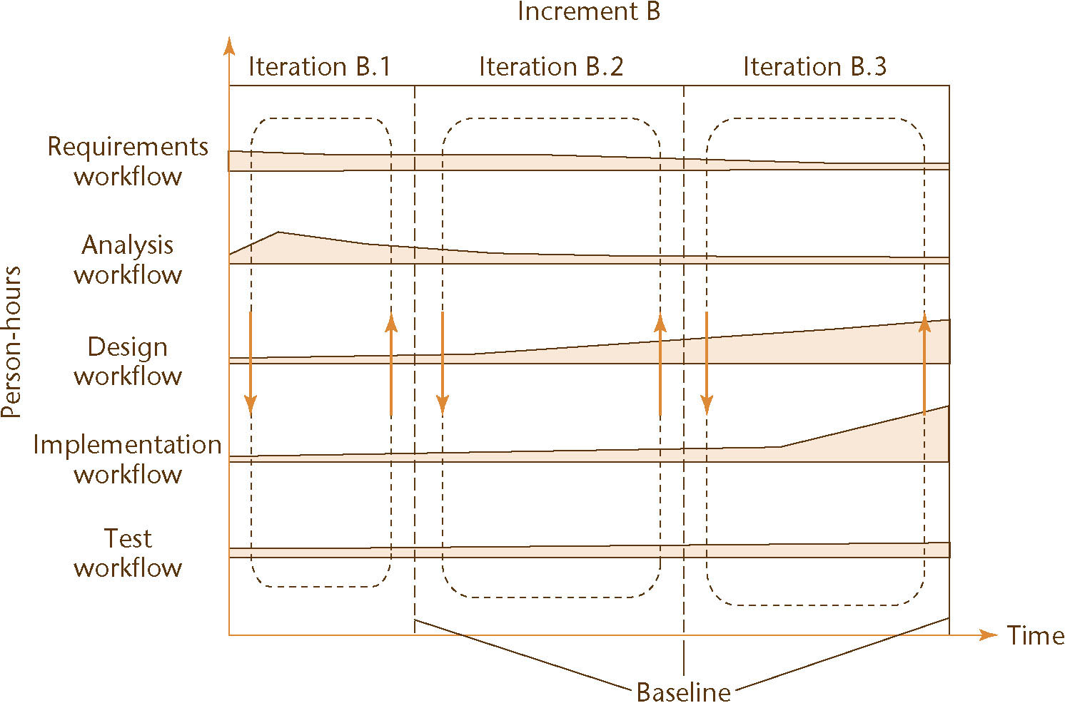
Iteration and Incrementation (contd)
Iteration is performed during each incrementation
Figure 2.5

Slide 20
Risks and Other Aspects of Iter. and Increm.
We can consider the project as a whole as a set of mini projects (increments)
Each mini project extends the
  Requirements artifacts
  Analysis artifacts
  Design artifacts
  Implementation artifacts
  Testing artifacts
The final set of artifacts is the complete product

Slide 21
Risks and Other Aspects of Iter. and Increm. (contd)
During each mini project we
  Extend the artifacts (incrementation);
  Check the artifacts (test workflow); and
  If necessary, change the relevant artifacts (iteration)

Slide 22
Risks and Other Aspects of Iter. and Increm. (contd)
Each iteration can be viewed as a small but complete waterfall life-cycle model
During each iteration we select a portion of the software product
On that portion we perform the
  Classical requirements phase
  Classical analysis phase
  Classical design phase
  Classical implementation phase

Slide 23
Strengths of the Iterative-and-Incremental Model
There are multiple opportunities for checking that the software product is correct
  Every iteration incorporates the test workflow
  Faults can be detected and corrected early
The robustness of the architecture can be determined early in the life cycle
  Architecture — the various component modules and how they fit together
  Robustness — the property of being able to handle extensions and changes without falling apart

Slide 24
Strengths of the Iterative-and-Incremental Model (contd)
We can mitigate (resolve) risks early
  Risks are invariably involved in software development and maintenance
We have a working version of the software product from the start
  The client and users can experiment with this version to determine what changes are needed
Variation: Deliver partial versions to smooth the introduction of the new product in the client organization

Slide 25
Strengths of the Iterative-and-Incremental Model (contd)
There is empirical evidence that the life-cycle model works
The CHAOS reports of the Standish Group (see overleaf) show that the percentage of successful products increases

Slide 26
Other Life-Cycle Models
The following life-cycle models are presented and compared:
  Code-and-fix life-cycle model
  Waterfall life-cycle model
  Rapid prototyping life-cycle model
  Open-source life-cycle model
  Agile processes
  Synchronize-and-stabilize life-cycle model
  Spiral life-cycle model

Slide 27
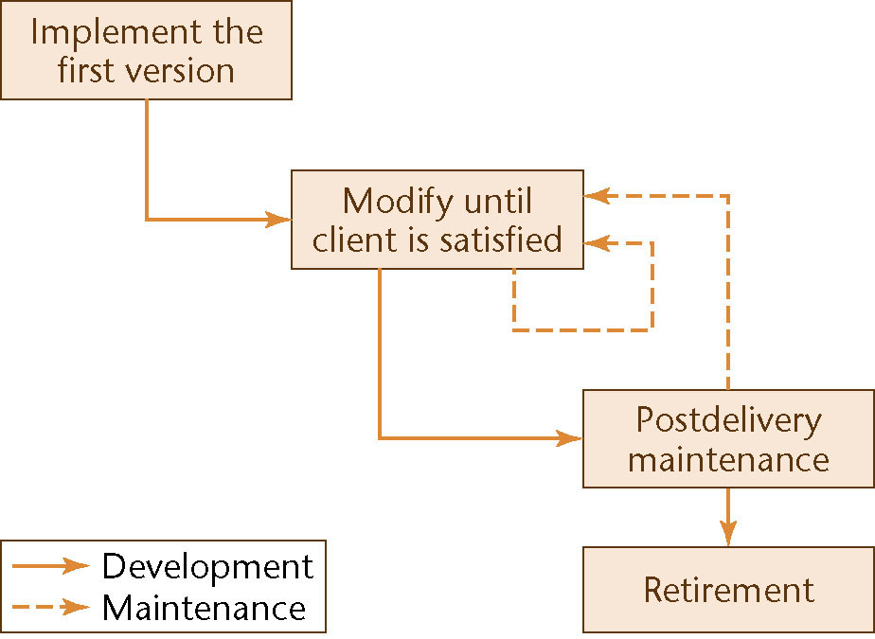
Code-and-Fix Model
No design
No specifications
  Maintenance nightmare
Figure 2.8

Slide 28
Code-and-Fix Model (contd)
The easiest way to develop software
The most expensive way

Slide 29
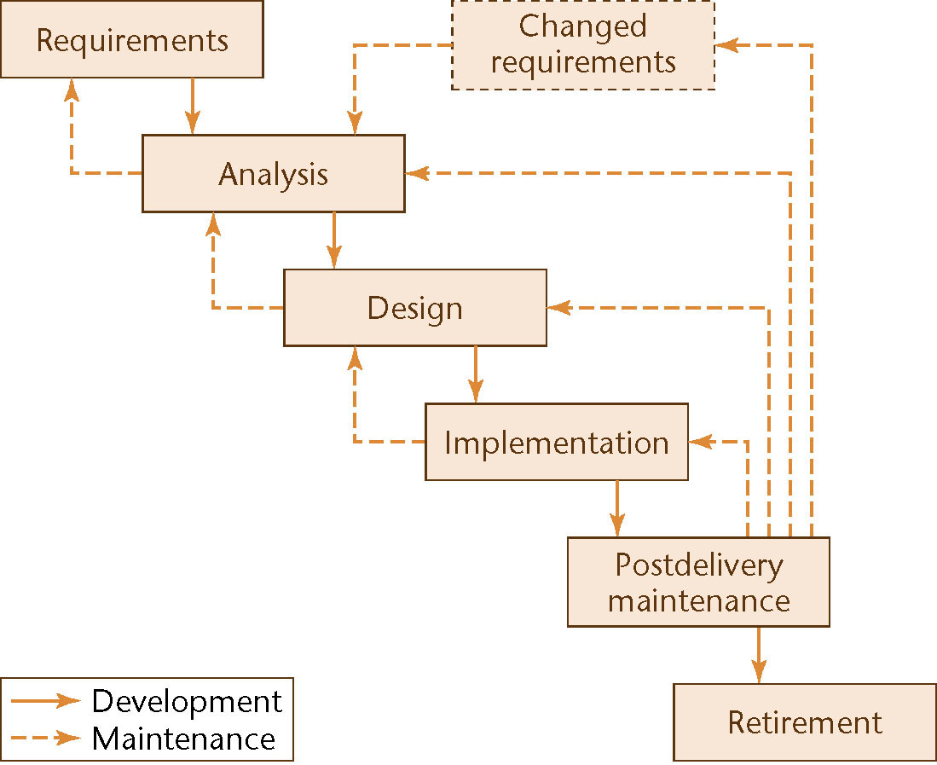
Waterfall Model
Figure 2.9

Slide 30
Waterfall Model (contd)
Characterized by
  Feedback loops
  Documentation-driven
Advantages
  Documentation
  Maintenance is easier
Disadvantages
  Specification document
    Joe and Jane Johnson
    Mark Marberry

Slide 31
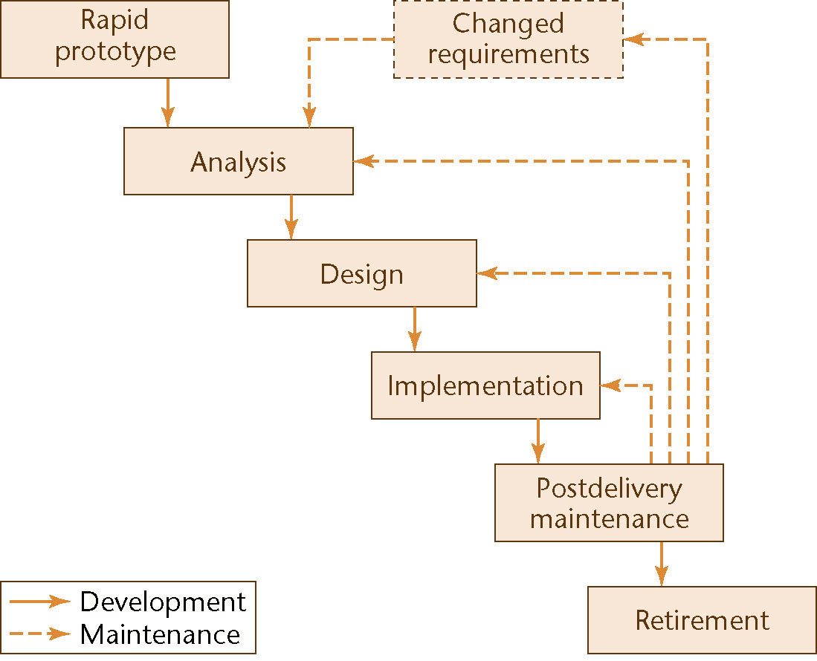
Rapid Prototyping Model
Linear model
“Rapid”
Figure 2.10

Slide 32
Open-Source Life-Cycle Model
Two informal phases
First, one individual builds an initial version
  Made available via the Internet (e.g., SourceForge.net)
Then, if there is sufficient interest in the project
  The initial version is widely downloaded
  Users become co-developers
  The product is extended
Key point: Individuals generally work voluntarily on an open-source project in their spare time

Slide 33
The Activities of the Second Informal Phase
Reporting and correcting defects
  Corrective maintenance
Adding additional functionality
  Perfective maintenance
Porting the program to a new environment
  Adaptive maintenance
The second informal phase consists solely of postdelivery maintenance
  The word “co-developers” on the previous slide should rather be “co-maintainers”

Slide 34
Agile Processes
Somewhat controversial new approach
Stories (features client wants)
  Estimate duration and cost of each story
  Select stories for next build
  Each build is divided into tasks
  Test cases for a task are drawn up first
Pair programming
Continuous integration of tasks

Slide 35
Unusual Features of XP
The computers are put in the center of a large room lined with cubicles
A client representative is always present
Software professionals cannot work overtime for 2 successive weeks
No specialization
Refactoring (design modification)

Slide 36
Acronyms of Extreme Programming
YAGNI (you aren’t gonna need it)
DTSTTCPW (do the simplest thing that could possibly work)
A principle of XP is to minimize the number of features
  There is no need to build a product that does any more than what the client actually needs

Slide 37
Agile Processes
XP is one of a number of new paradigms collectively referred to as agile processes
Seventeen software developers (later dubbed the “Agile Alliance”) met at a Utah ski resort for two days in February 2001 and produced the Manifesto for Agile Software Development
The Agile Alliance did not prescribe a specific life-cycle model
  Instead, they laid out a group of underlying principles

Slide 38
Agile Processes
Agile processes are a collection of new paradigms characterized by
  Less emphasis on analysis and design
  Earlier implementation (working software is considered more important than documentation)
  Responsiveness to change
  Close collaboration with the client

Slide 39
Agile Processes (contd)
A principle in the Manifesto is
  Deliver working software frequently
  Ideally every 2 or 3 weeks
One way of achieving this is to use timeboxing
  Used for many years as a time-management technique
A specific amount of time is set aside for a task
  Typically 3 weeks for each iteration
  The team members then do the best job they can during that time

Slide 40
Agile Processes (contd)
It gives the client confidence to know that a new version with additional functionality will arrive every 3 weeks
The developers know that they will have 3 weeks (but no more) to deliver a new iteration
  Without client interference of any kind
If it is impossible to complete the entire task in the timebox, the work may be reduced (“descoped”)
  Agile processes demand fixed time, not fixed features

Slide 41
Agile Processes (contd)
Another common feature of agile processes is stand-up meetings
  Short meetings held at a regular time each day
  Attendance is required
Participants stand in a circle
  They do not sit around a table
  To ensure the meeting lasts no more than 15 minutes

Slide 42
Agile Processes (contd)
At a stand-up meeting, each team member in turn answers five questions:
  What have I done since yesterday’s meeting?
  What am I working on today?
  What problems are preventing me from achieving this?
  What have we forgotten?
  What did I learn that I would like to share with the team?

Slide 43
Agile Processes (contd)
The aim of a stand-up meeting is
  To raise problems
  Not solve them
Solutions are found at follow-up meetings, preferably held directly after the stand-up meeting

Slide 44
Agile Processes (contd)
Stand-up meetings and timeboxing are both
  Successful management techniques
  Now utilized within the context of agile processes
Both techniques are instances of two basic principles that underlie all agile methods:
  Communication; and
  Satisfying the client’s needs as quickly as possible

Slide 45
Evaluating Agile Processes
Agile processes have had some successes with small-scale software development
  However, medium- and large-scale software development is very different
The key decider: the impact of agile processes on postdelivery maintenance
  Refactoring is an essential component of agile processes
  Refactoring continues during maintenance
  Will refactoring increase the cost of post-delivery maintenance, as indicated by preliminary research?

Slide 46
Evaluating Agile Processes (contd)
Agile processes are good when requirements are vague or changing
It is too soon to evaluate agile processes
  There are not enough data yet
Even if agile processes prove to be disappointing
  Some features (such as pair programming) may be adopted as mainstream software engineering practices

Slide 47
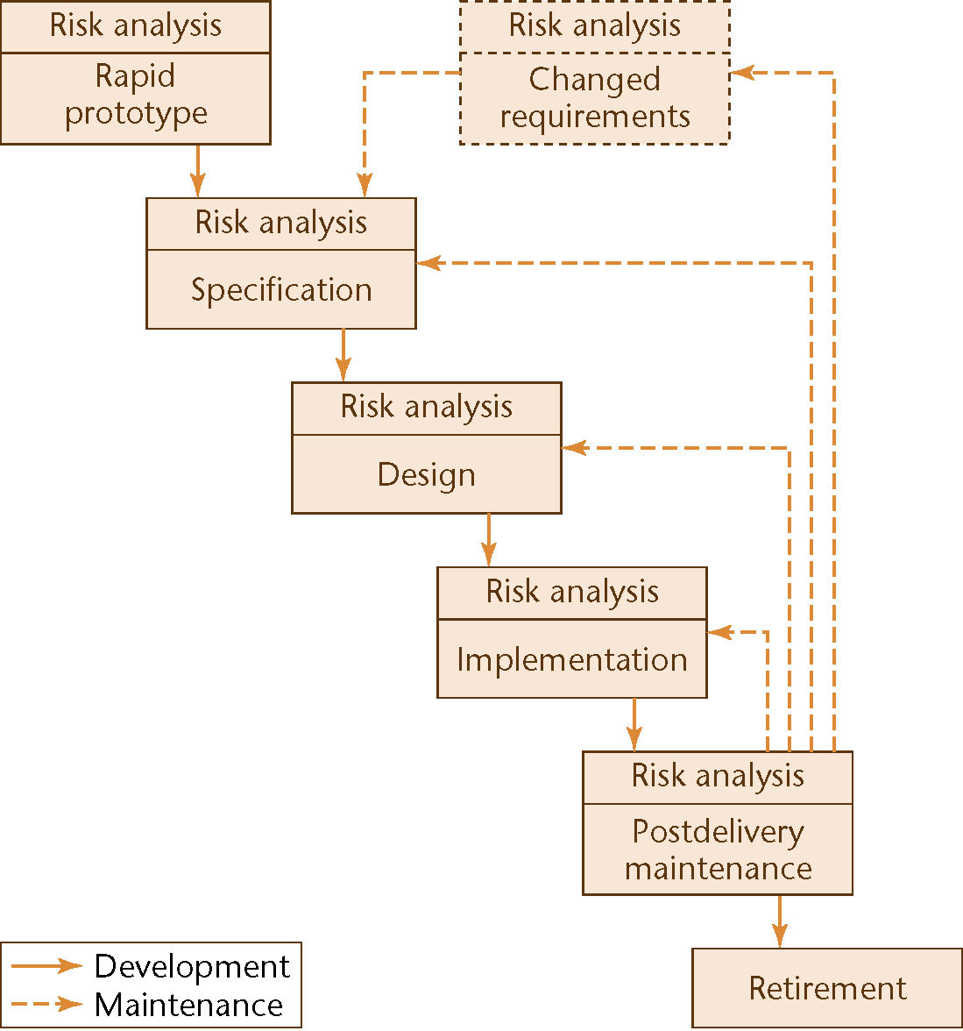
Spiral Model
Simplified form
  Rapid prototyping model plus risk analysis preceding each phase
Figure 2.12

Slide 48
A Key Point of the Spiral Model
If all risks cannot be mitigated, the project is immediately terminated

Slide 49
Full Spiral Model
Precede each phase by
  Alternatives
  Risk analysis
Follow each phase by
  Evaluation
  Planning of the next phase
Radial dimension: cumulative cost to date
Angular dimension: progress through the spiral

Slide 50
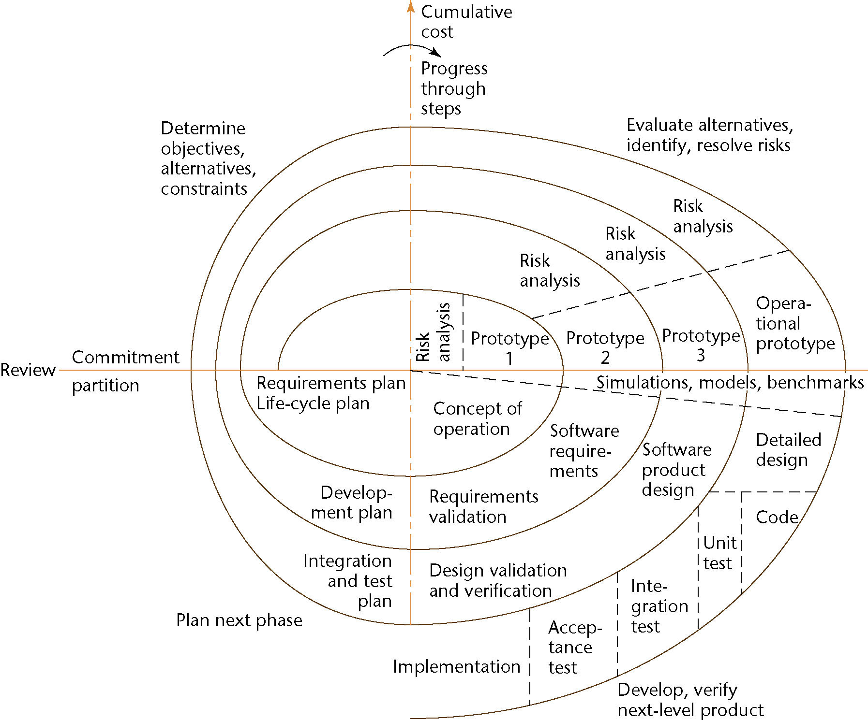
Full Spiral Model (contd)
Figure 2.13

Slide 51
Analysis of the Spiral Model
Strengths
  It is easy to judge how much to test
  No distinction is made between development and maintenance
Weaknesses
  For large-scale software only
  For internal (in-house) software only

Slide 52
Comparison of Life-Cycle Models
Different life-cycle models have been presented
  Each with its own strengths and weaknesses
Criteria for deciding on a model include:
  The organization
  Its management
  The skills of the employees
  The nature of the product
Best suggestion
  “Mix-and-match” life-cycle model

Slide 53
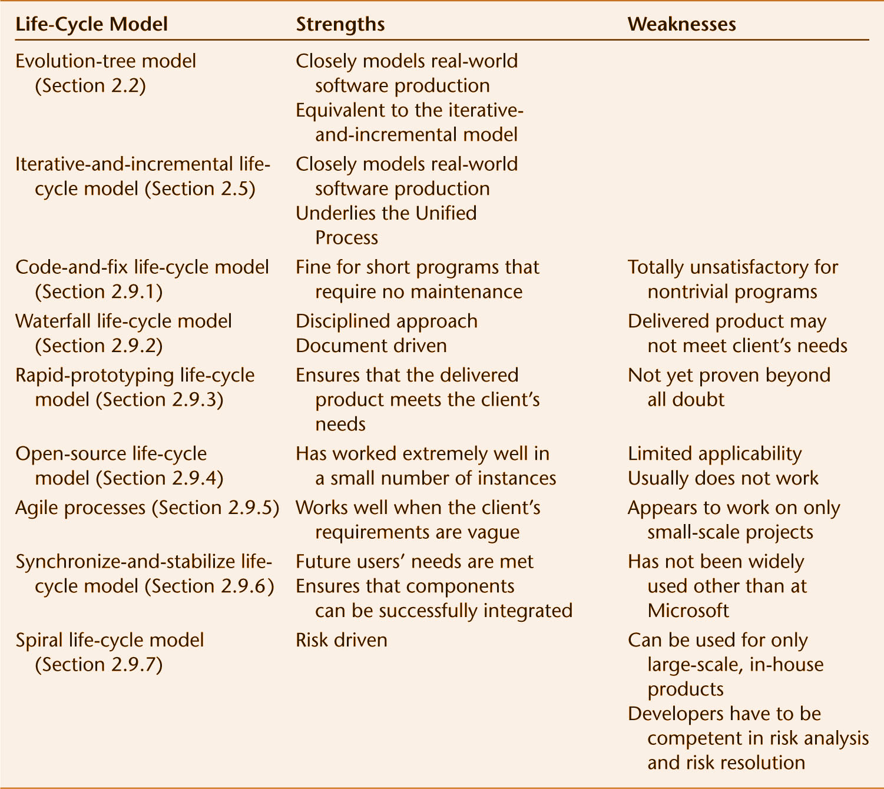
Comparison of Life-Cycle Models (contd)
Figure 2.14

